Slide 1

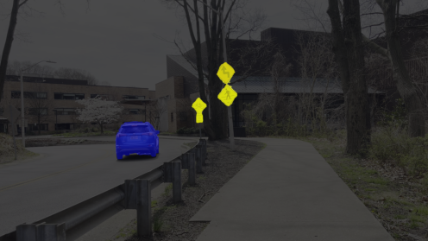
Results
Before Training
Qualitative
Visualizing Validation Results During Training
Validation Data: JHU_street_05_img0027
After Training

